Slide 1
The Battle of neighborhoods
Hyderabad vs Bangalore
By Sri Ram Chintapalli

Slide 2
Business Problem:
A customer wants to compare the neighborhoods of Hyderabad and Bangalore. So that would provide some insights of locations that are suitable for buying a House and starting his new food cart business. To do such we need to compare the areas using the Data Analytics and Machine learning algorithm(K-means) which will help the customer to take decision on settling down/buying house/starting his own business.

Slide 3
Data :
Following data sources would be needed to generate the required information:
• Data will be scrapped for the locations using below URLs:
https://www.mapsofindia.com/pincode/india/telangana/hyderabad/
https://www.mapsofindia.com/pincode/india/karnataka/bangalore/
• All venues or neighborhood areas through Foursquare API
• Geocoder (google maps) to get coordinates of neighborhoods

Slide 4
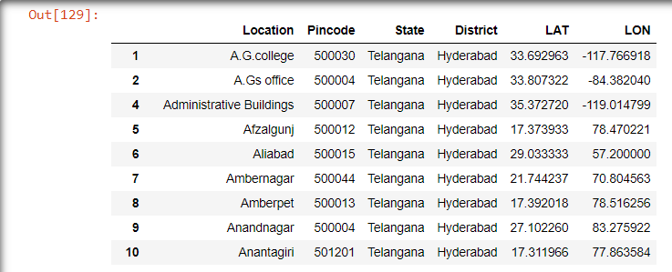
Final Data frames of Hyderabad

Slide 5
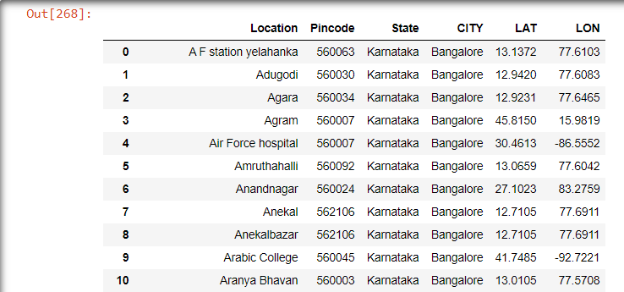
Final Data frames of Bangalore

Slide 6
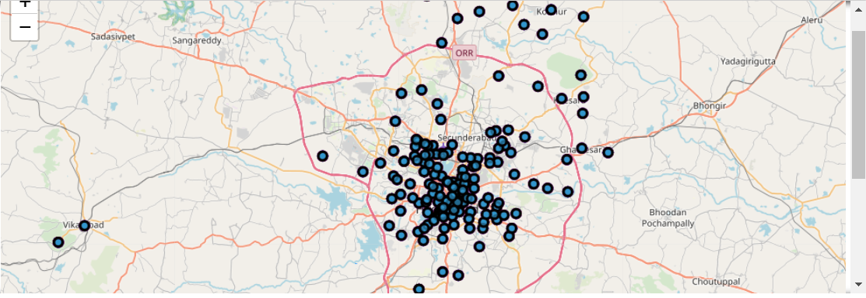
Folium map Hyderabad:

Slide 7
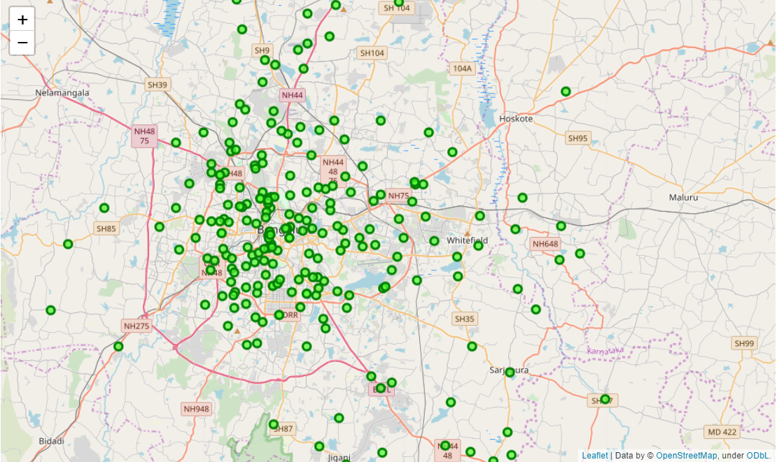
Folium Map Bangalore:

Slide 8
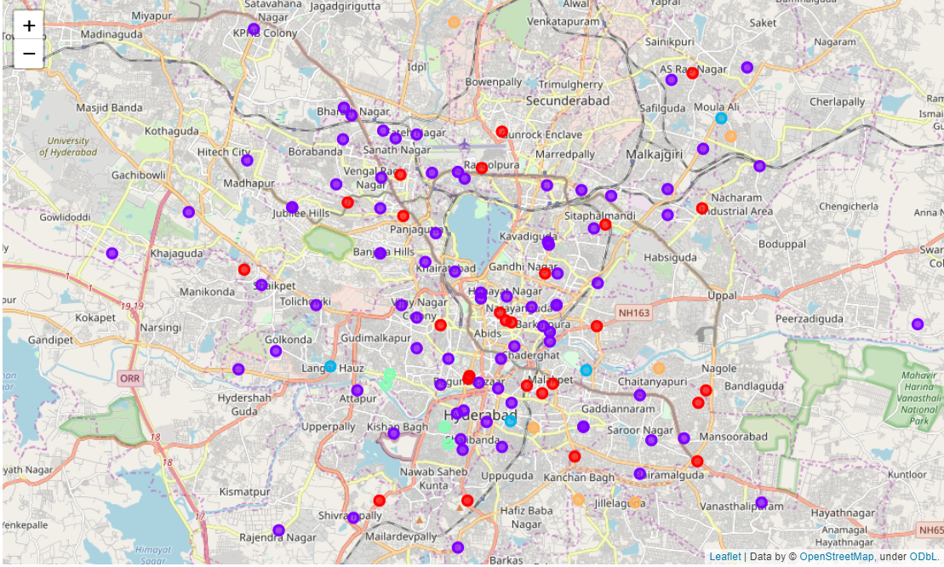
K-Means Clustering-HYD

Slide 9
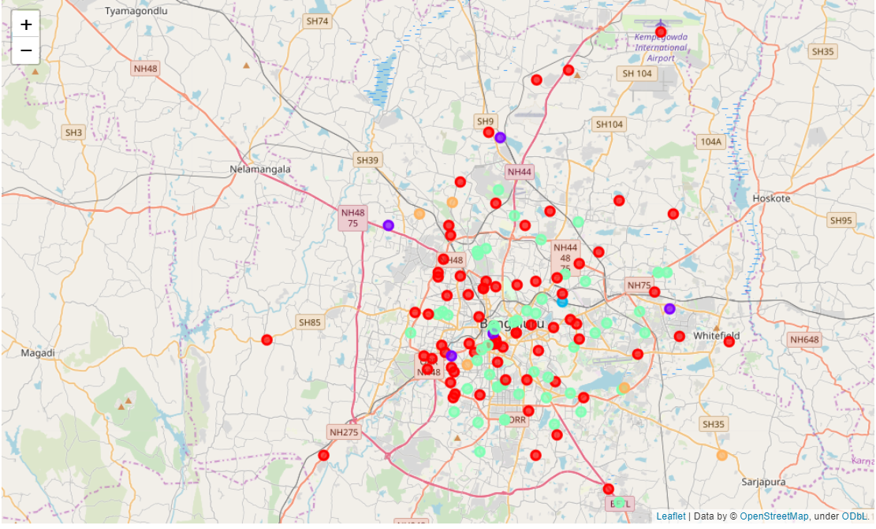
K-means clustering-BAN

Slide 10
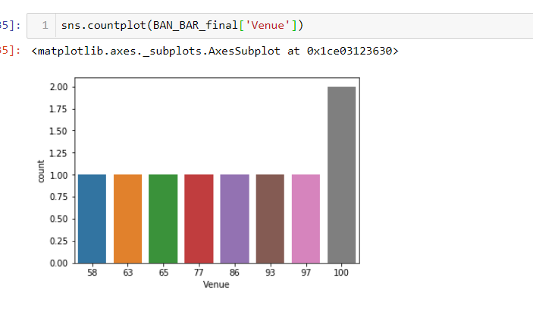
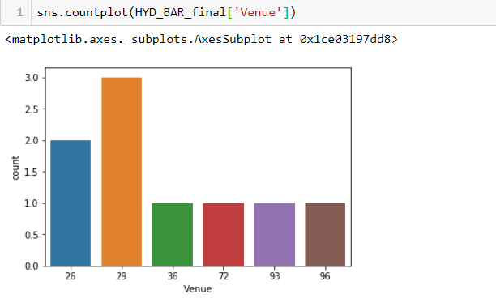
Conclusion:
Analysis:
Using Foursquare API, we have capture data of common places for HYDERABAD and BANGALORE. Using it, we refer back to our main objectives, which is to determine the Best Place to buy home and Start a new food cart business. In conclusion, both cities HYDERABAD and BANGALORE are metropolitan cities in India. However, to find which cities is best base on common venues visited is quite difficult. But we can assume for some extent of results to be correct based on the total venues and food options in each neighborhood.
Thank you

